Slide 1

STACK OVERFLOW
DEVELOPER SURVEY 2019
Babatunde Olaleye
December 15, 2022

Slide 2

OUTLINE
• Executive Summary
• Introduction
• Methodology
• Results
• Visualization – Charts
• Dashboard
• Discussion
• Findings & Implications
• Conclusion
• Appendix

Slide 3

EXECUTIVE SUMMARY
• Relevant skills required in the field of IT and business
consulting are ever-changing and evolving.
• It is important to identify future skill requirements and trends to
keep pace with changing technologies and remain competitive.
• This presentation will show current and future trends
in Programming Languages, Databases, Platforms
and WebFrames.
• Overall, the aim in identifying future skill requirements
and trends is to help the firm make more informed data-
driven hiring and budgetary decisions.

Slide 4

INTRODUCTION
• This presentation has been created for stakeholders
and business decision makers within the global IT and business
consulting services firm.
• The presentation will help identify future skill requirements in
the global IT sector necessary for the firm to keep pace with
changing technologies and remain competitive.
• Recommendations will be stated based on the analysis.

Slide 5

METHODOLOGY
• Using a modified subset of the Stack Overflow dataset¹, the data was
wrangled in order to remove duplicates, impute missing values and
normalize data.
• Next, the data underwent exploratory analysis in order to find the
distribution of data, presence of outliers and determine the correlation
between different columns in the dataset.
• The data was then used to visualize the distribution, the relationship
between two features and the composition and comparison of data.
• Finally, after downloading two files², which are also a modified subset of
the Stack Overflow dataset, Cognos Dashboard Embedded (CDE) was used
to create the “Current Technology Usage”, “Future Technology Trends” and
“Demographics” slides.
• Appendix
To obtain average annual salaries web scraping was used to extract
information from a website then saved to a csv file.

Slide 6

RESULTS

Slide 7
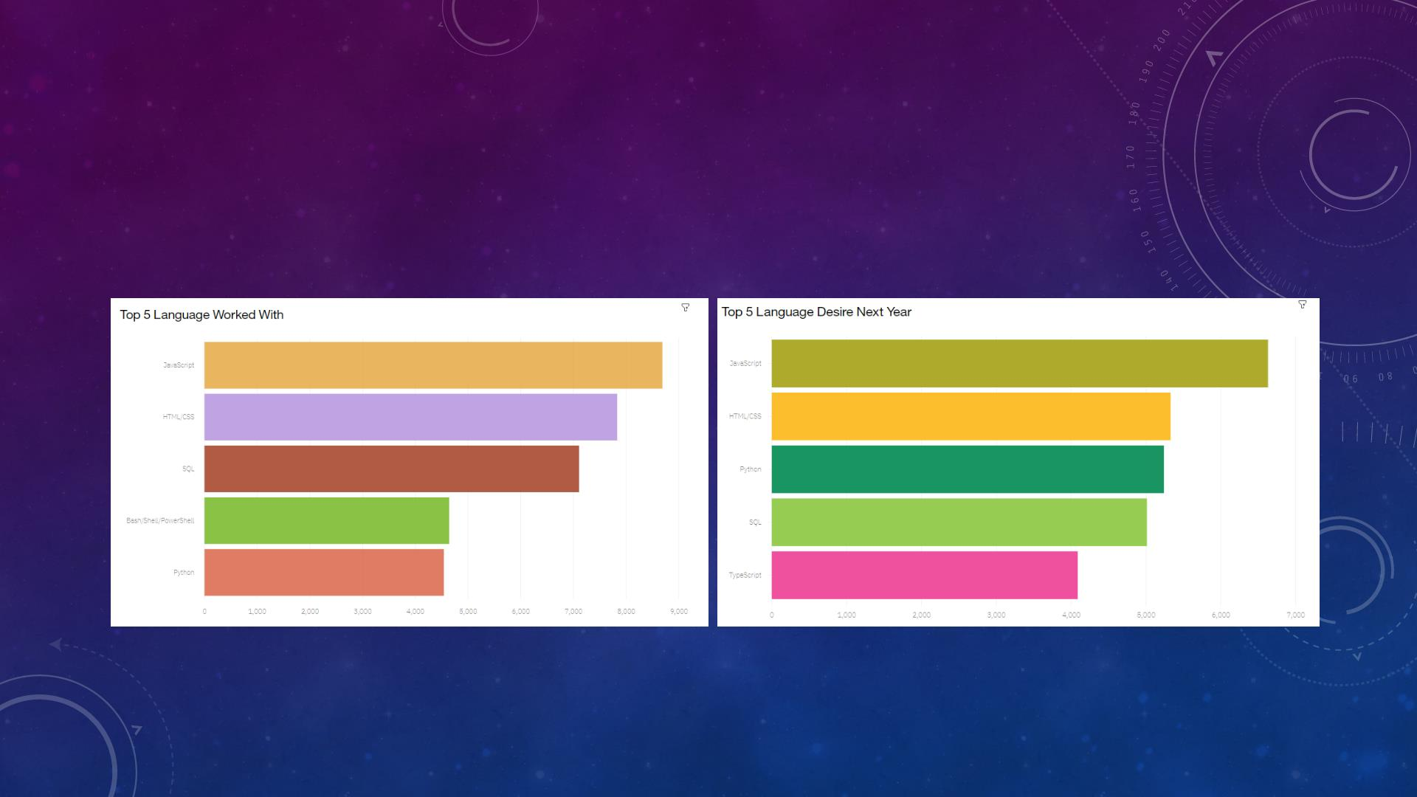
PROGRAMMING LANGUAGE TRENDS
Current Year
Next Year

Slide 8

PROGRAMMING LANGUAGE TRENDS - FINDINGS &
IMPLICATIONS
Implications
1
Continue to employ a similar number of people
skilled in JavaScript and HTML/CSS.
• JavaScript and HTML/CSS
continue to be the top two most
popular programming languages
for this year and next.
• Python and TypeScript have
gained more interest for next
y ear.
Findings
2
3
Employ more people skilled in Python
and TypeScript.
• Whereas interest in
SQL and Bash/Shell/PowerShell
has decreased.
Employ less people skilled in SQL
and Bash/Shell/PowerShell.

Slide 9
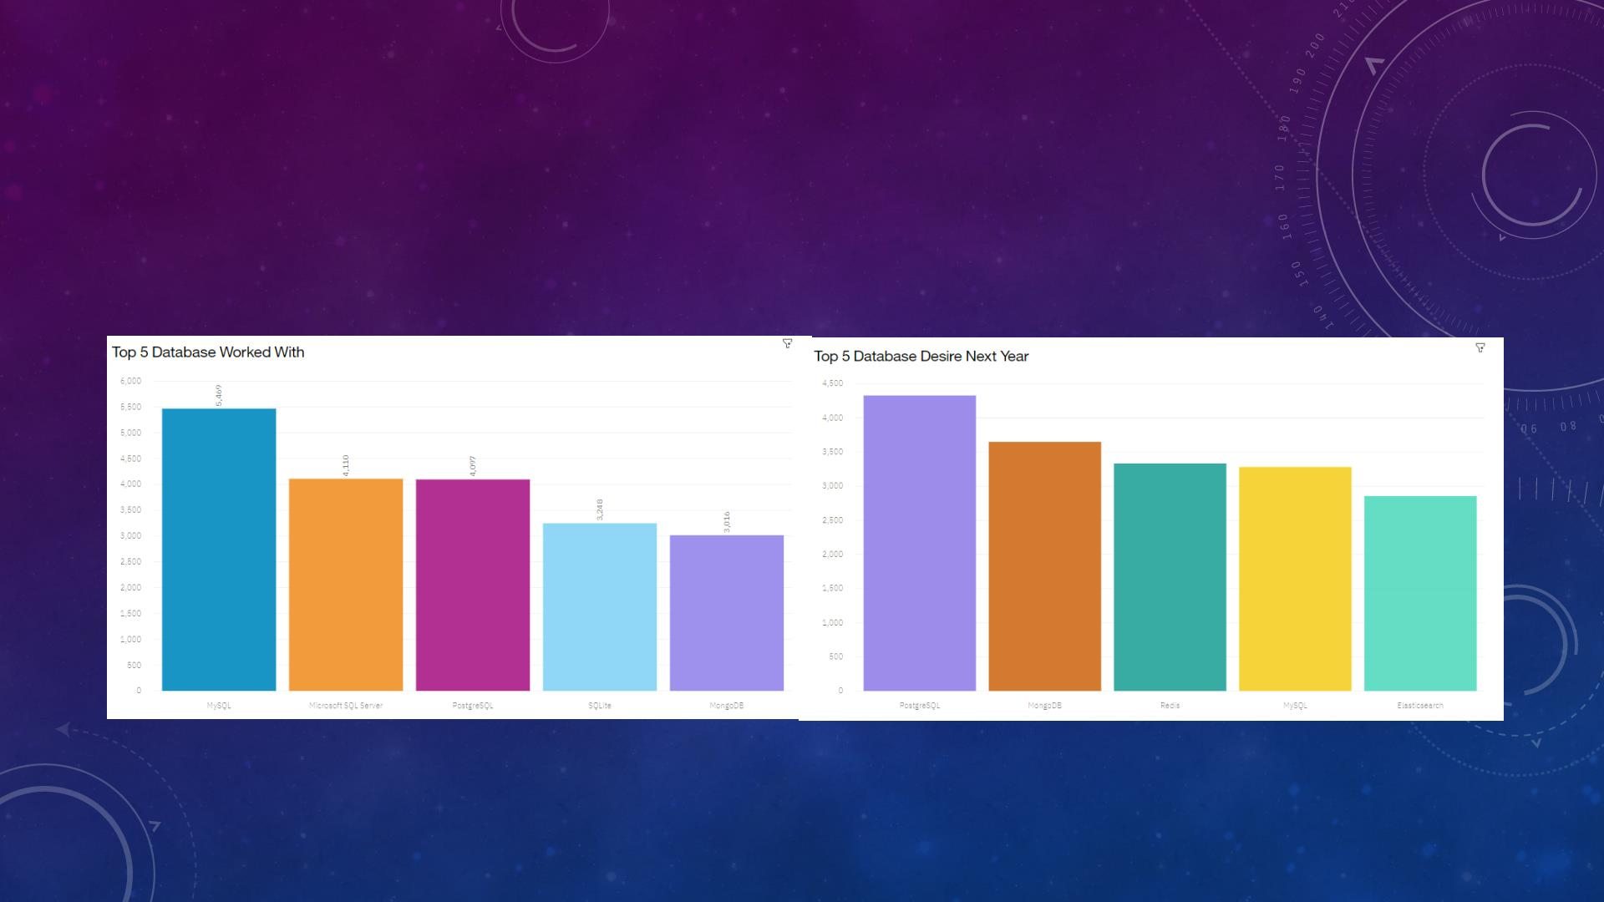
DATABASE TRENDS
Current Year
Next Year

Slide 10

DATABASE TRENDS - FINDINGS & IMPLICATIONS
Implications
1
Employ less people skilled in
MySQL, Microsoft SQL Server and SQLite.
• Interest in MySQL, Microsoft
SQL Server and SQLite has
decreased for next year.
Findings
• Interest in PostgreSQL and
MongoDB have increased
compared to the current year.
• There is gained interest in
Redis and Elasticsearch for
next year.
2
3
Employ more people skilled in
PostgreSQL and MongoDB.
Employ more people skilled in Redis
and Elasticsearch.

Slide 11

DASHBOARD

Slide 12
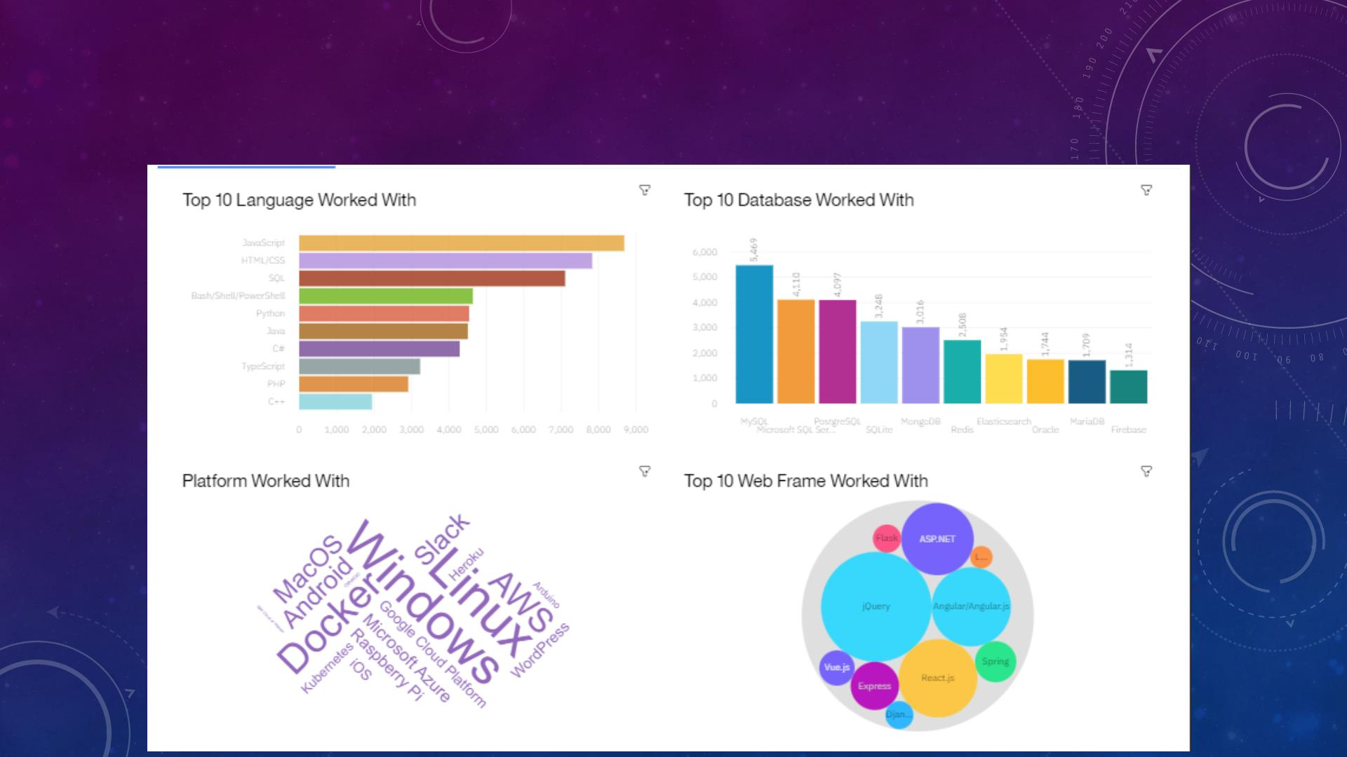
DASHBOARD TAB 1

Slide 13
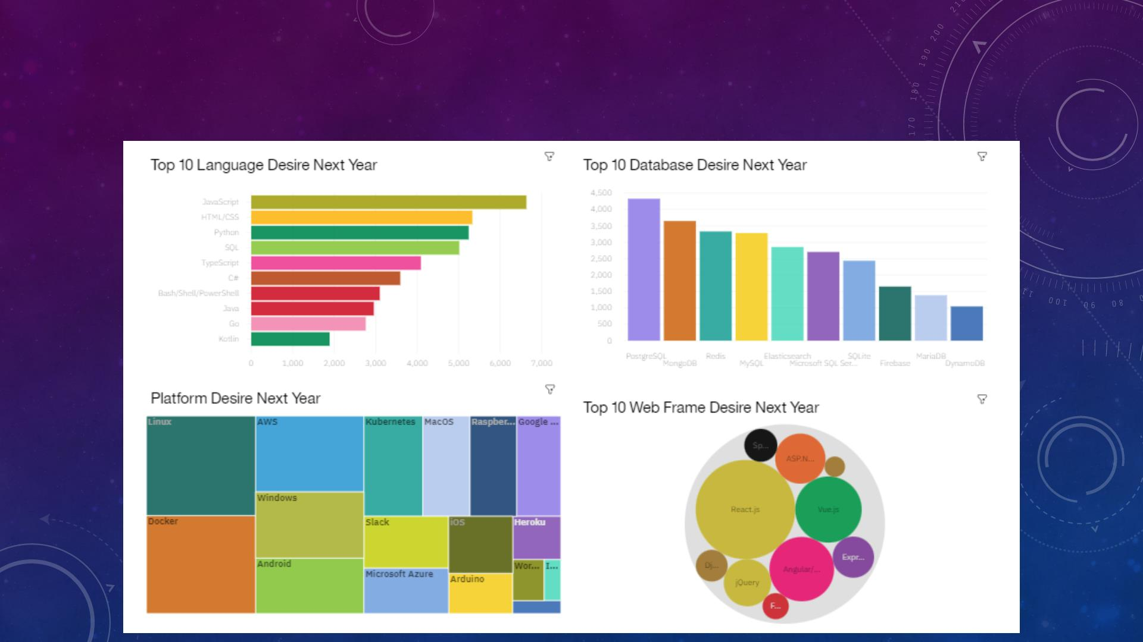
DASHBOARD TAB 2

Slide 14
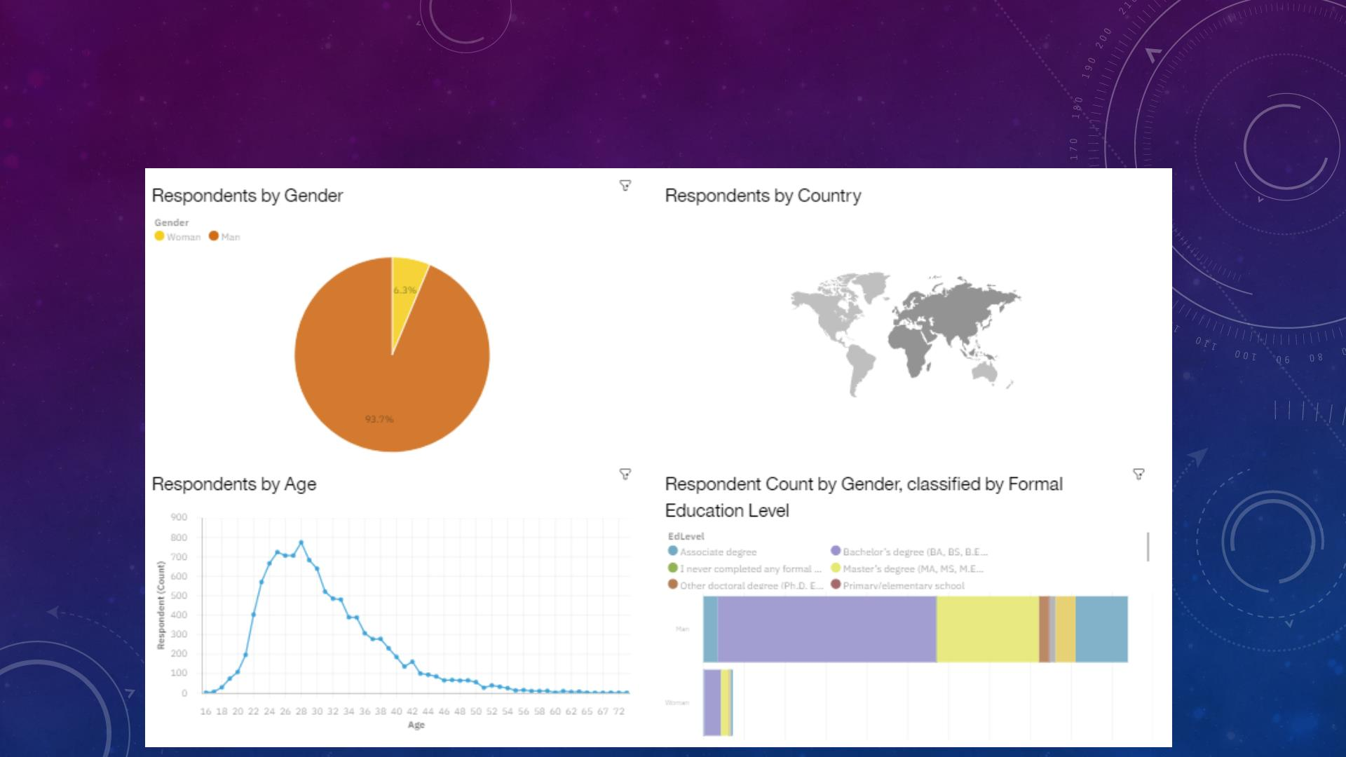
DASHBOARD TAB 3

Slide 15

DISCUSSION

Slide 16

OVERALL FINDINGS & IMPLICATIONS
Implications
1
Continue to staff enough JavaScript and HTML/CSS but employ
more people skilled in TypeScriptandPython.
•Programming Languages - TypeScript
is gaining significant interest
and Python continues to grow as well.
• Databases - Redis, Elasticsearch,
2
Employ more people skilled in Redis,Elasticsearch, PostgreSQL
and MongoDB.
Findings
PostgreSQL and MongoDB are gaining
more interest.
•Platforms - I nterest Slack and Windows
is dropping significantly.
•WebFrames - Vue.js is gaining
substantial interest and React.js
continues to grow as well.
3
4
Continue to staff enough ASP.NETbut employ more people
skilled in Vue.js and React.js.
Continue to staff enoughLinux, employ more people skilled in
Docker, AWS andAndroid, but make reductions to Slack and
Windows.

Slide 17

CONCLUSION
1
2
3
Carve out budget in order to hire additional staff
with skills needed to fill any gaps.
Set aside budget or put a program in place
to upskill those already employed.
Make adjustments in staff for those skills
no longer in demand.

Slide 18

APPENDIX

Slide 19
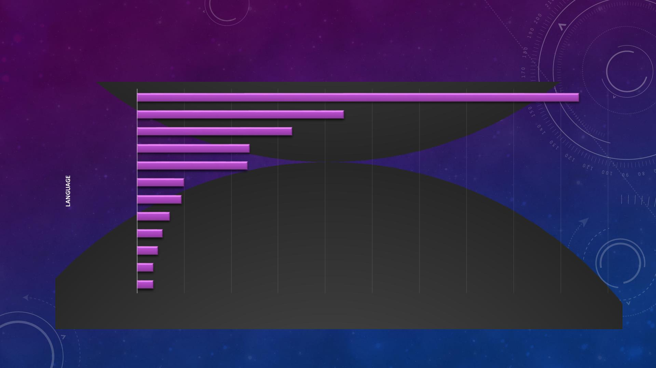
GITHUB JOB POSTINGS
C
Java
188
88
JavaScript
66
Python
Scala
48
47
C#
20
19
C++
SQL Server
PostgreSQL
Oracle
14
11
9
MongoDB
MySQL Server
7
7
0
20
40
60
80
100
120
140
160
180
200
NUMBER OF JOB POSTINGS

Slide 20
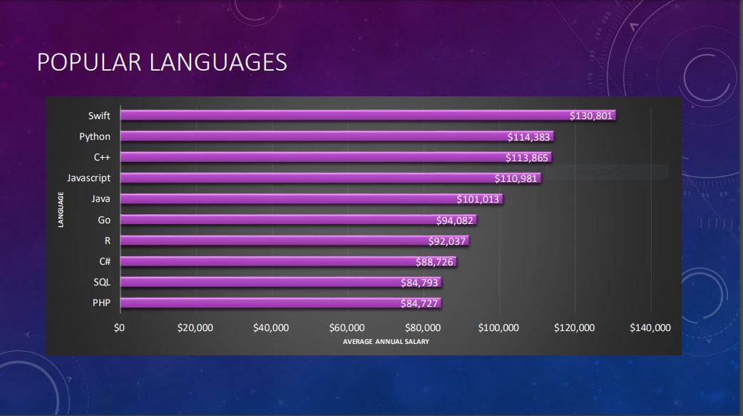

Slide 21

RESOURCE
1. https://stackoverflow.blog/2019/04/09/the-2019-stack-overflow-developer-survey-results-are-in/
2. m5_survey_data_demographics.csv and m5_survey_data_technologies_normalised.csv
3. https://jobs.github.com/api
4. github-job-postings.xlsx
5. https://cf-courses-data.s3.us.cloud-object-storage.appdomain.cloud/IBM-DA0321EN-
SkillsNetwork/labs/datasets/Programming_Languages.html

Slide 22
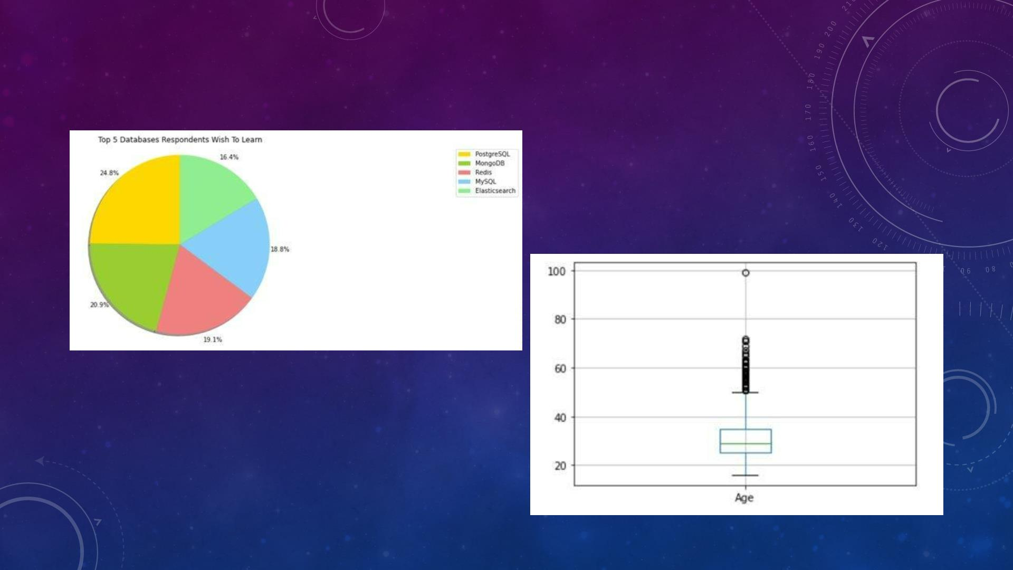
ADDITIONAL VISUALS
Box Plot of Age of Survey Respondents

